Slide 1
Want to automate measurements?
Week 4
Emec/Phys 310
Brian Rasnow

Slide 2

Tired of manual data entry (already)?
Any time you find yourself doing a mundane task repeatedly, think of automation
This is the main reason why worker productivity has increased so dramatically in the USA
Wages haven’t followed, resulting in growing wealth disparity, debt, and poverty for workers …
What kinds of tasks do humans still beat machines at??
Those are the things you need to learn to do well – because if you try to out-compete machines at what they’re good at, you’ll lose!!
https://www.epi.org/productivity-pay-gap/

Slide 3
Automating voltage measurements
Before C19 we’d do this late in the class …
But why not take advantage of productivity benefits now?
Some benefits of automated measurements
Faster: humans are very slow at measuring and logging data
Better accuracy: from speed, averaging, biases, eliminate copying mistakes, …
Repeatable: if you mess anything up, fix it and rerun the automated lab
Documented: Source code is the most precise documentation
…
Some costs of automation (“no free lunches”)
Complexity → solution is …
Reductionism – modularize the problem
Too much data → solution is …
Automate data analysis

Slide 4
Arduinos are cheap awesome microcontrollers
www.arduino.cc – go to the Software -> Download page and download and install the IDE (integrated development environment) for your computer
That’s the easy part of the battle to get your computer to talk to your Arduino … more to come
Background: what’s a microcontroller? How does it differ from a microcomputer, like a laptop or a Raspberry pi (https://www.raspberrypi.org)?

Slide 5
Microcontrollers
μCs are software programmable devices like computers but they are much simpler (https://en.wikipedia.org/wiki/Microcontroller)
The Arduino doesn’t have an (accessible) operating system nor file system
Arduino runs two programs (that’s it!): setup(); and loop();
When it boots, it runs setup(); once, and then loop(); over and over.
Arduino’s IDE facilitates writing the code within those 2 functions (in the C language), compiling, uploading it, and otherwise communicating with the Arduino

Slide 6

Microcontroller history
These devices used to be proprietary and very expensive
Academics in Italy decided to make open-source hardware and software, and the Arduino platform flourished
Similarly, Unix operating systems were $$$ so Linus Torvald organized the open-source Linux (https://en.wikipedia.org/wiki/Linux)
This was followed by open-source computer hardware, of which the Raspberry pi is perhaps the most successful. I highly recommend you get one to learn
Check out https://twisteros.com for a windows or mac like OS
More about the history and philosophy of open source – a revolutionary challenge to classical capitalist ideas of innovation can be found in this book …

Slide 7
Arduino IDE installation
After installing the IDE from www.arduino.cc, the battle continues …
Our cheap Arduinos use a nonstandard CH340g usb interface, so you must install a driver for it (and reboot):
https://learn.sparkfun.com/tutorials/how-to-install-ch340-drivers/all
Plug in your Arduino and launch the IDE
Tools menu -> Board -> Arduino Nano
Tools menu -> Processor -> ATmega328P (Try Old Bootloader if the default doesn’t work)
Tools menu -> Port -> on Windows, select the COM port that appears and disappears when you plug in/out the Arduino. On Mac, it will have a different name, like /dev/cu.usbserial14120 that also appears and disappears when the Arduino is plugged in and out
Tools menu -> Programmer -> AVRISP mkII
Good news is you generally only have to do this once, the settings should be remembered …
File menu -> Examples -> 01.Basic -> Blink, scroll down and change one or both delay(1000) arguments (1000 msec = 1 sec sets the blink rate).
Click on the ➔ button at the top left of the window to upload the new blink rate to the Arduino, and you should see the change …
If so, you’re ready to program … if not … debugging time …

Slide 8
Data logging with Arduino
We have to co-develop 3 things (complexity … no free lunch):
Hardware interface to the Arduino
Software interface to query the hardware and generate data (this software runs on the Arduino)
Data interface, to interpret and reduce the data (this software does not have to run on the μC – it could (often should) be in Matlab, Excel, … running on a host computer
1. Hardware interface functions
Protect the μC from dangerous voltages, transients, …
Ensure the signals you wish to measure are within a safe range
Ensure that noise doesn’t unduly contaminate the signals of interest
May include triggering and other state signals

Slide 9
Arduino Nano Analog Input
Our Nanos are 5V (there are also 3.3V ones – careful), so their input range is 0-~4.5V
The analog-to-digital converter (ADC) is ideally linear, mapping 0-4.5V to integers 0-1023 (2^10-1)
There are 8 Analog input pins, A0-A7, that can be sampled collectively at ~9800 times per second (btw, that’s pretty slow – digital oscilloscopes sample at up to a few billion measurements/sec
Arduino measures one pin (channel) at a time
(Note: Arduino can measure faster with less resolution, e.g., ~100ksamples/sec at 8 bit resolution, but doing so requires programming in assembly language, not C)
Other microcontrollers like the Raspberry pi Nano have >100ksample/sec ADCs with 12 bit (or more) resolution

Slide 10
Hardware to measure LED I-V curve
We can use the variable V_{out} of the LM317 through R_{series} to vary the current through the LED: R_{series} = 12V/10mA ~ 1kΩ
V_{out} of the LM317 ranges from ~1.25-12V … how do we map that into 0-4.5V that we can measure?
Think about it before going on …

Slide 11
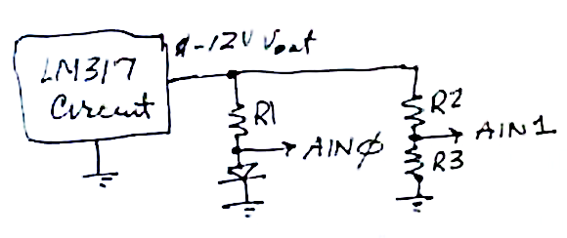
1. Hardware interface design
We can use the variable V_{out} of the LM317 through R₁ to vary the current through the LED: R₁ = 12V/10mA ~ 1kΩ
V_{out} of the LM317 ranges from ~ 1.25-12V … how do we map that into 0-4.5V? Voltage divider:
V_{out} = V_{in} * R₃/(R₂+R₃) so
4.5 = 12 * R₃/(R₂+R₃) … one equation and 2 unknowns
We haven’t discussed impedance matching yet (but we will), the idea is that R₃ has to be much smaller than the impedance of the Arduino’s A1, and big enough to not waste power. Z_{A1} >> 10kΩ, so let R₃ = 10kΩ – a 2nd equation
→ R₂ =~ 20kΩ (exercise: check the algebra).
Add 10k resistors in series with A0 and A1 as current limiters
Under normal circumstances there should be no current into A0 and A1, so they should do nothing … but under abnormal conditions, they will limit current into the Arduino, possibly saving it from smoking
Gnd

Slide 12
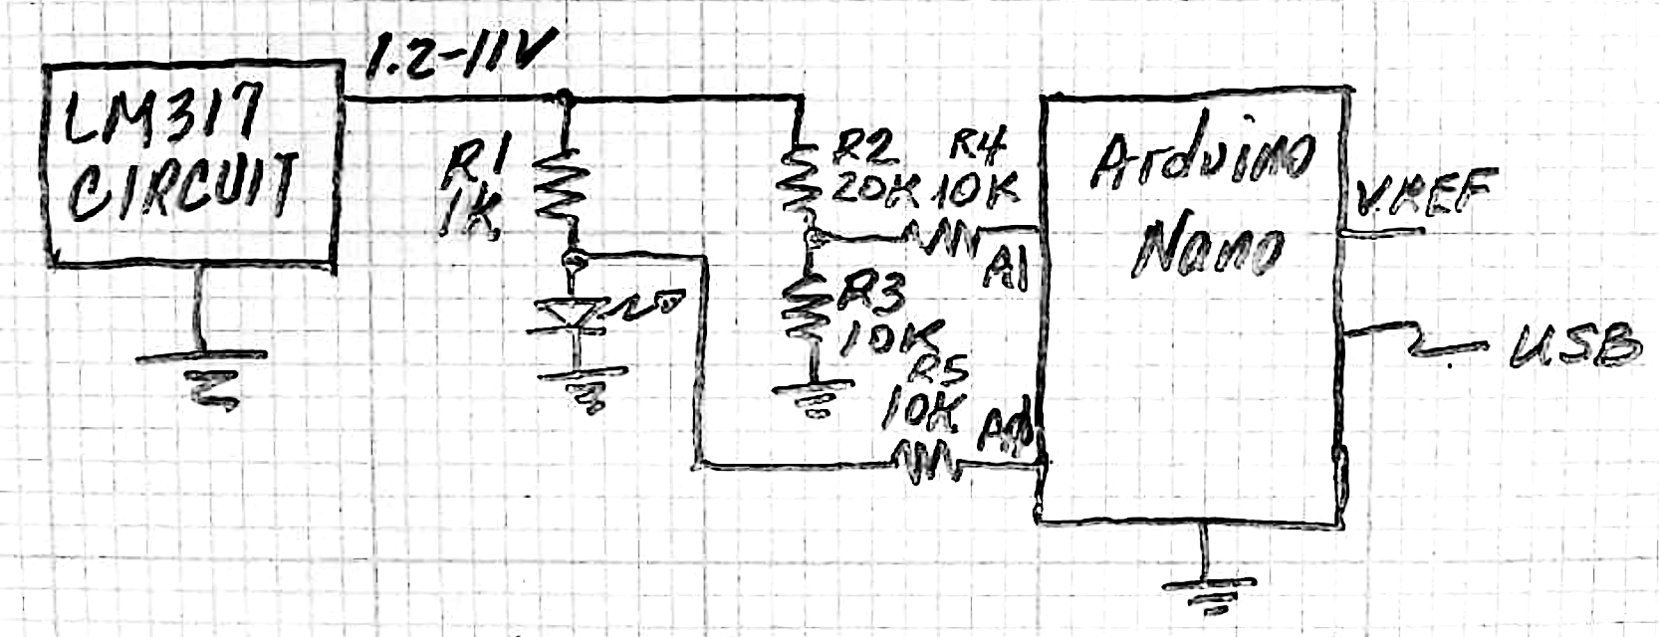
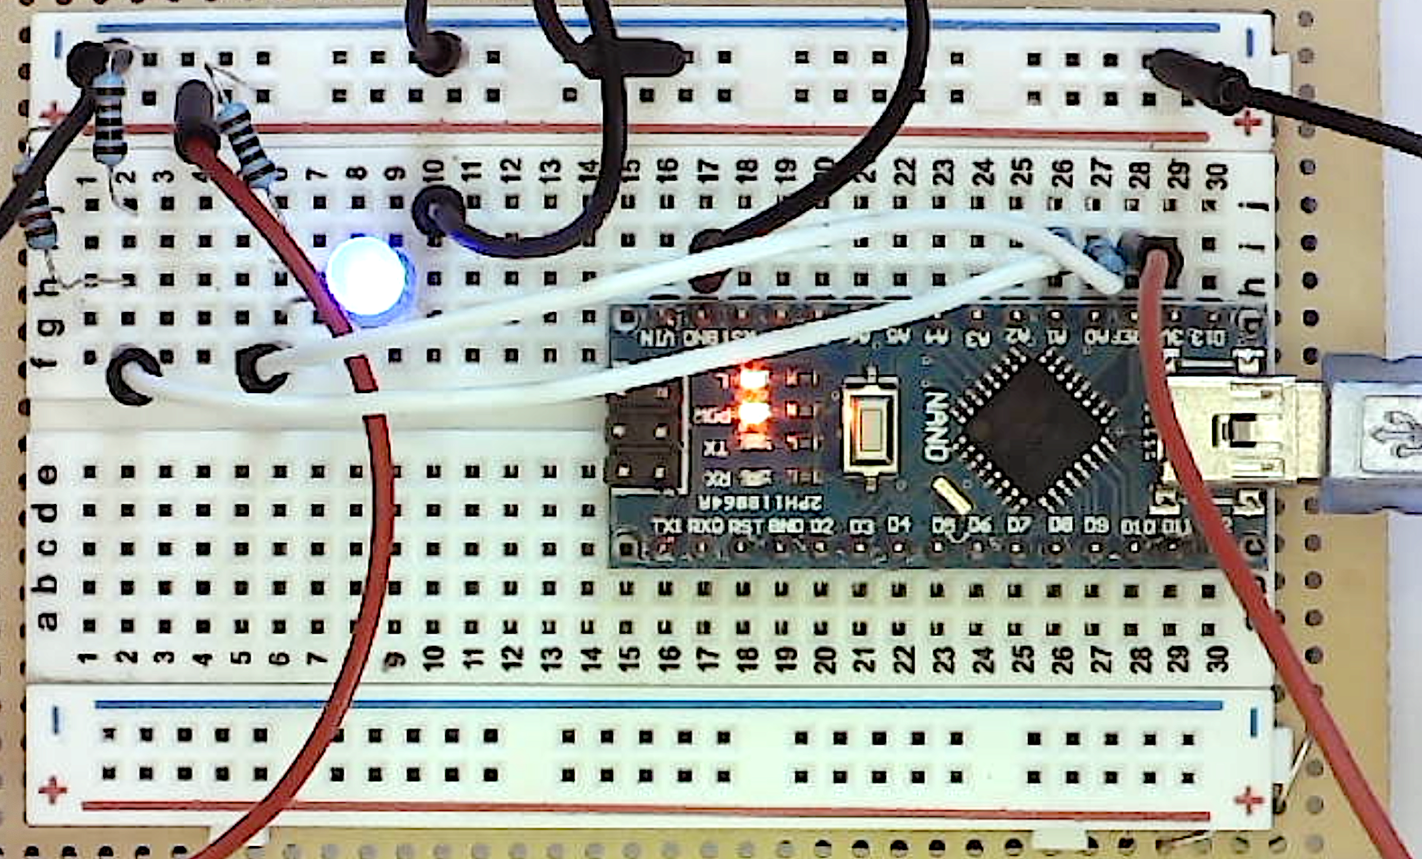
1. Hardware interface construction
R1 limits LED current
R2 and R3 are voltage dividers protecting Arduino
R4 and R5 are current limiting resistors, soldered to the white wires
VREF is indicated reminding you to carefully measure it (safest from a jumper wire plugged into the breadboard, to avoid shorting adjacent Arduino pins with your voltmeter)
Don’t forget to connect Arduino GND to LM317 GND (black jumper in upper column 17)
Gnd
R3
R1
R2
R4
R5
VREF

Slide 13
2. Software Interface
Look for an Arduino example that we can tweak … we want to read analog inputs A0 and A1 and print the results. How about:
IDE File menu -> Examples -> 01.Basic->AnalogReadSerial
void setup() {
// initialize serial communication at 9600 bits per second:
Serial.begin(9600);
}
// the loop routine runs over and over again forever:
void loop() {
// read the input on analog pin 0:
int sensorValue = analogRead(A0);
// print out the value you read:
Serial.println(sensorValue);
delay(1); // delay in between reads for stability
}
Safest if we can understand everything before we tweak it …

Slide 14
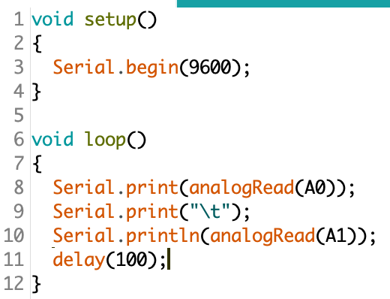
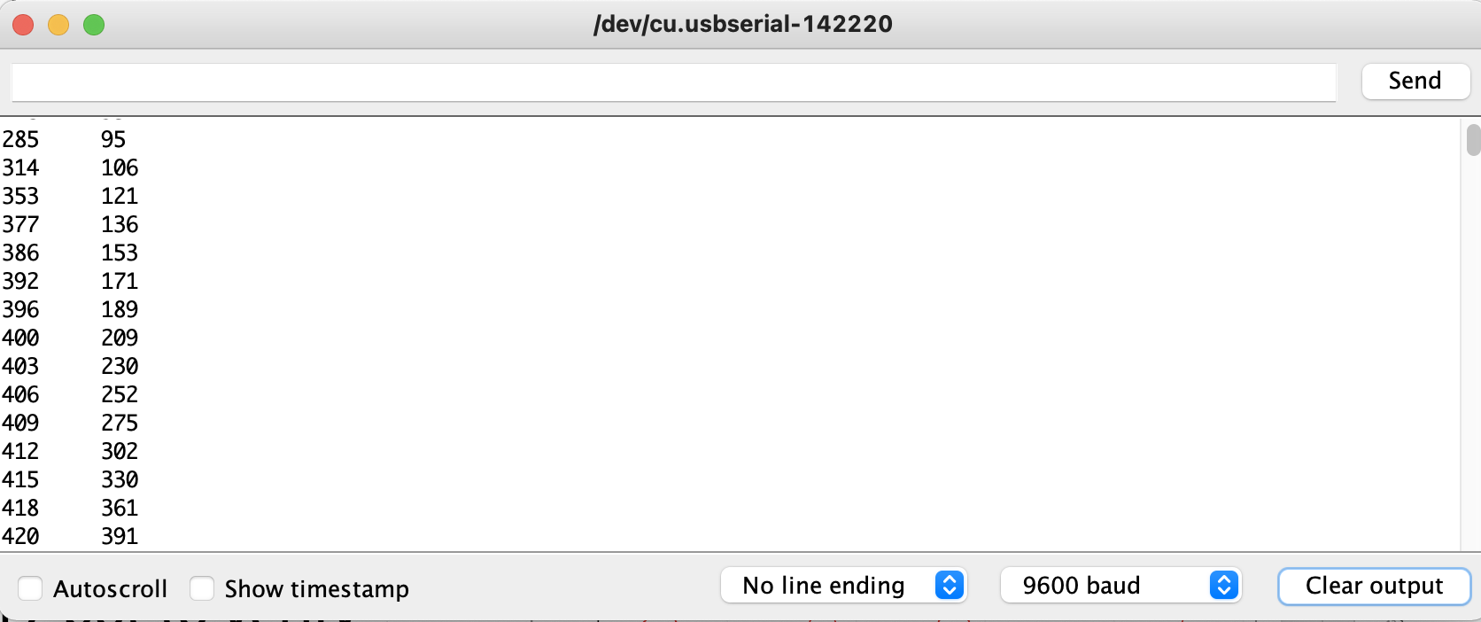
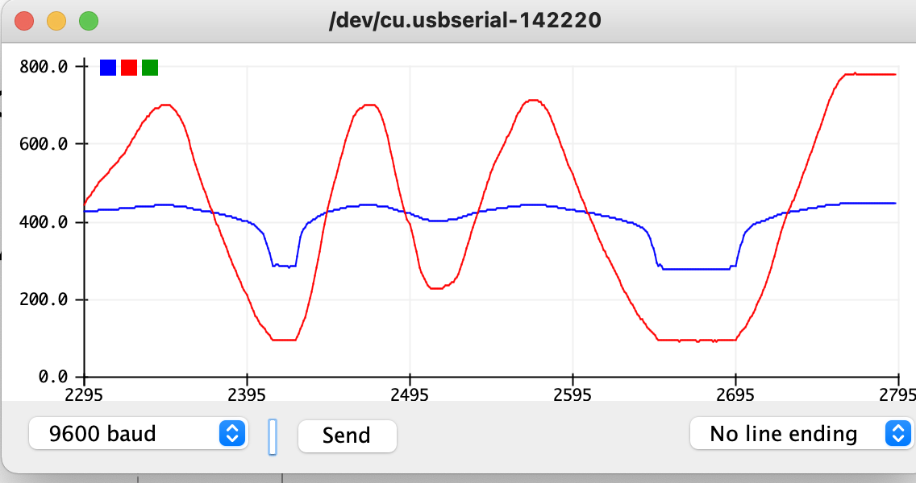
2. Software Interface
The simplest code that prints analog voltages on A0 and A1 (in units of ADU, 1023 ADU = VREF volts (~4.5V, measured – carefully – on the VREF pin)
At a minimum, you should add a comment describing the code’s function and your name and date
You can view the output with either Tools -> Serial Monitor or Serial Printer (but not simultaneously – close one before opening the other)
Turn the LM317 pot to verify
Serial Monitor
Serial Plotter

Slide 15
3. Data Interface
Tools -> Serial Monitor (or click on magnifying glass icon on top right of window) is where the output should appear
Make sure the baud rate at the bottom of the window matches the 9600 baud in setup()
Copy and paste it into Matlab …
data = [...% A0 A1
… (paste the numbers)
];
VREF = 4.62; % volts measured on Arduino’s VREF Pin
A0 = data(:,1); A1 = data(:,2)
R1 = 1000; R2 = 20e3; R3 = 10e3; % ohms
vLED = A0 * VREF/1023;
vR1 = A1 * VREF/1023 * (R2+R3)/R3 - vLED;
iLED = vR1 / R1;
plot(vLED, iLED, '.-');
grid;
Xlabel('Volts'); ylabel('mA'); title('LED I-V curve');

Slide 16
My data
Wouldn’t want to do this without automation!

Slide 17
Raw data
Don’t make a mistake of not reducing the raw data …
The raw data looks pretty rough – because I didn’t turn the 10k pot knob very smoothly
The jumps vanish when the raw data is processed and the i-v curve is plotted

Slide 18
Repeating the experiment
With data collection, reduction, and visualization automated, it doesn’t take much additional work to repeat with other LEDs or other devices (rectifier diodes, resistors – but be careful to keep A0’s voltage < VREF – there’s no voltage divider there)
The code will need some tweaks to get this …
Where do you think green and yellow LEDs will be?
Try 100 and 200 ohm resistors
If you substitute a larger R, you risk violating the 1st point
Try a silicon rectifier … explain.

Slide 19
Lab Report
Objective: Automate measuring I-V curves with an Arduino Nano
I was going to write, “measuring an LED’s I-V curve …” but realized, there’s no reason we can’t use this to measure other I-V curves by just swapping the device …
Take advantage of the efficiency to measure a resistor’s I-V curve, i.e., put a 100Ω and 220Ω resistor in place of the LED; measure a green and yellow LED, etc.
Matlab’s hold on; hold off; functions let you superimpose the plots
Methods: We already broke it into 3 sections, this is where the source codes and schematics can go
Results: the graphs from Matlab
Discussion: reflect some more … what are some questions you can attempt to answer?? E.g.,
Why are i-v curves also called “characteristic curves”?
How similar are the curves for 2 LEDs of the same and different color?
Are these curves exponential? (hint: replace plot with semilogy or loglog)
…

Slide 21
Rasnow’s take on Code Commenting
File menu -> Examples -> 01.Basic->AnalogReadSerial
void setup() {
// initialize serial communication at 9600 bits per second:
Serial.begin(9600);
}
This comment is dangerous and superfluous. If we later change the baud rate, we’ll likely forget to change the comment → Comments fall out of sync with the code, and then add confusion instead of reducing it
My solution is:
Make the executable code self-documenting, e.g.,
const int baudRate = 9600;
Serial.begin(baudRate);
(Now there’s no need for comments, and the code will do what it says, even if the baud rate changes … btw, if you don’t know what baud rate is, then call the variable commSpeed or whatever you’re comfortable with)
Minimize comments for general, stable information (e.g., your name and date at the top of the file; revision history; …
Avoid convoluted code where you can – compilers are pretty good at turning humanly readable prose into executable code

Slide 22
Rasnow’s take on Code Commenting
File menu -> Examples -> 01.Basic->AnalogReadSerial
void loop() {
// read the input on analog pin 0:
int sensorValue = analogRead(A0);
// print out the value you read:
Serial.println(sensorValue);
delay(1); // delay in between reads for stability
}
These comments are superfluous … analogRead reads analog, Serial.println ”prints” with the serial port, delay() delays … anyone can figure that out. The real questions you may have is what is A0, and how long is a delay of 1 (1 what?) We can answer these questions in executable code, e.g., #define and const are 2 ways to use meaningful variable names without using more memory
#define temperatureSensorPin A0
const int delayTime = 1; // msec
void loop(){
Serial.println(analogRead(temperatureSensorPin));
delay(delayTime);
}

Slide 23
Programs for Programming
How do we approach programming?
Is there a consistent method to our madness?
Do we understand the underlying assumptions of the processes we try to follow?
There are formally described programming processes (e.g., waterfall, heavyweight OO, etc.), and corresponding cultures (e.g., distributions of responsibilities) and technologies (e.g., UML, CASE tools, etc.) for implementing these processes.
Some new programming processes are evolving that better cope with recent changes in the software marketplace, in particular, rapid change associated with the internet, and open source. Extreme Programming (XP) is one such approach.

Slide 24
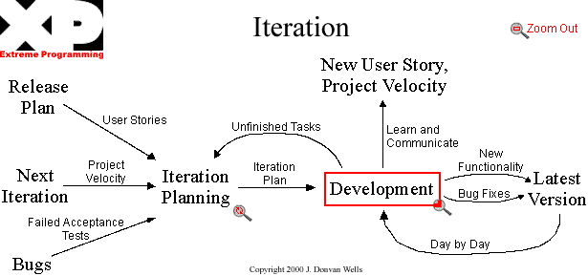
The next few slides represent the XP process in bubbles.
Planning is a verbal process, with customer input on scope (features) and their relative importance, and developer input on implementation time, risk, and alternatives.
The metrics are written in code as automated tests of the features for this (and previous) iterations.
The only "paper" trail is code versions.
www.extremeprogramming.org

Slide 25
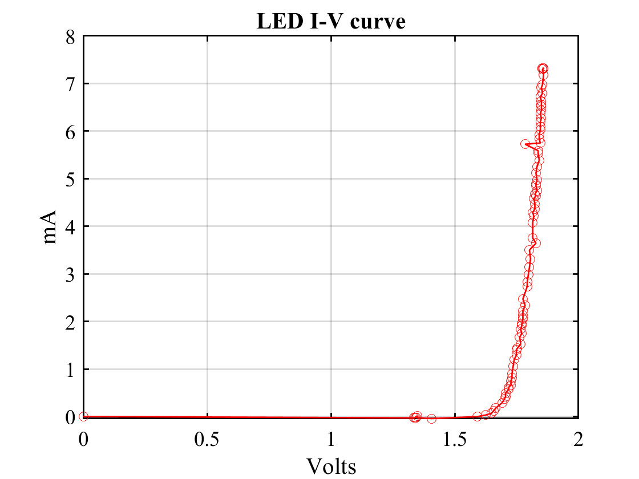
“Big data”
Automation often reveals new problems, like how to handle glitches or outliers – e.g., we seem to have one just below 6mA
Automated curve smoothing maybe a good solution
Linear filters average data, reducing the magnitude of outliers
Statistical filters seek to find and remove outliers – they are thus nonlinear
Overfiltering data often creates artifacts, so test and understand what your filter is removing (or adding)
Automate your testing
That way if you tweak your algorithm, its easy (or auto- matic) to rerun the validation
E.g., Java’s assert

Slide 26
Reflection and Questions
Numerous big concepts were discussed here so I encourage you to review and revisit these slides a few times …
Microcontrollers vs. microcomputers
Installing Arduino IDE and CH340g serial driver
Automation requires codeveloping 3 interrelated components
hardware interface between system under test and the uC
uC software to generate the data
Data reduction software to generate results
Automating experiments adds this complexity but pays back with
Quantity of data is no longer a burden
Less variability in the data, no transcribing errors, …
If you mess up any aspect of the experiment, redoing it is trivially easy
Use a computer (or uC) for repetitive tasks that they do better than we can

Slide 27
Reflection and Questions
Two standard genres of scientific communication are Lab Reports and computer programs
Like writing essays and poetry in English classes, these require both respect of structures and norms, and creative expression within those constraints
I’ve presented some of the principles I’ve followed, that have served me in my career
Lab reports tell (your boss or peers) a story of a goal, the methods used to achieve that goal, results of following the method, significance and lessons learned.
Computer programs tell a computer (or uC) what to do … but in addition to executing, they have to be readable and understandable to our peers and our future selves. That second purpose is often neglected.
Each exercise in this class is an opportunity to practice and study different examples

Slide 28
Computer Assisted Design (CAD) is another kind of automation
Is it better learning to write using paper and pencil, or a word processor? How about using even more powerful LaTeX?
Writing isn’t just to communicate ideas to others, it also is a substrate for organizing our internal thoughts and ideas*
Schematics serve a similar role as writing in electronics
You will learn much more by drawing them often – repetition was how you learned to write
CAD can play a supporting role, but only if the mechanics of it don’t get in the way
CAD programs (like EAGLE) that are powerful tend to be complicated … so you may learn more practicing with the familiar user interface of graph paper and pencil
As your designs increase in complexity, CAD will become necessary
Not only to draw, but to simulate and validate behaviors
Use a computer (or uC) for repetitive tasks that they do better than we can
We can still beat computers with creativity and insights
* Discussed deeper in: https://prezi.com/bes4scop9ime/quality-in-writing/

Slide 29
Electronics CAD = EDA
Electronic design and analysis software (EDA) can facilitate multiple tasks
Schematic capture (drawing)
Printed circuit board (PCB) design or “routing”
Circuit simulation (e.g., SPICE)
Integrated circuit design, e.g., for very large-scale integration (VLSI, e.g., CPUs, MOSIS)
Eagle is an EDA tool that I used for 2 years
It’s a chore to learn it, videos like this one helped me: https://www.youtube.com/watch?feature=player_embedded&v=R4DYztYB6d4
Kicad (www.kicad.org) is a newer EDA tool that’s open source, and I like its workflow/interface, and lots of youtube and online help

Slide 30
Drawing the LM317 schematic in Eagle
I took some notes watching some introductory videos
Understand commands: select a “tool” first (e.g., move, add, rotate, delete, …), then select the object (backwards from many GUIs)
Autocad’s CLI is under the hood
Keyboard Copy/Cut/Paste are handy shortcuts
Place parts on the canvas, then move them around, then connect them
The libraries are vast -- * and ? are wildcards (from Unix)
Some of the parts I used were found after a lot of trial and error
File -> New -> Schematic
Add -> Frames -> FRAME_A_L
Esc
(still in Add mode)
Search -> *LM317* -> LM317TL
Esc
…

Slide 31
Drawing the schematic in Eagle
(still in Add mode)
Click [X> next to search and scroll to
rcl -> R-US_ -> R-US_-0207/12 (1/2” spacing)
Right click or control click (Macintosh) to rotate and click
rcl -> CPOL-USE2.5-6
control-click 3 times then click twice on either side of 317
Search *switch* -> TL360PO
library -> pot (Version 2) → TRIM_US-B25P …
library -> Supply1 -> +12
Supply1-> gndA

Slide 32
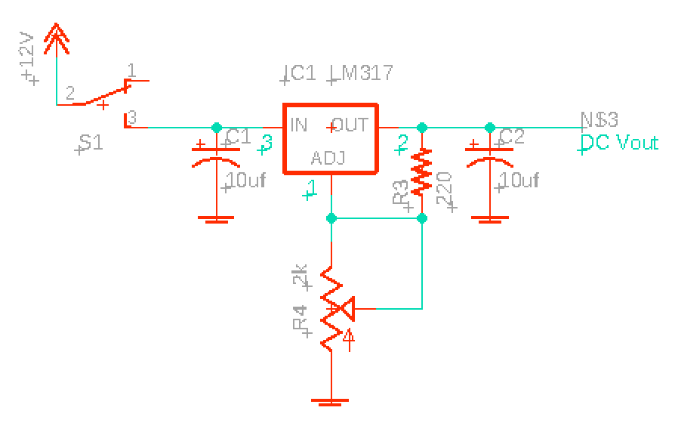
Drawing the schematic in Eagle
After connecting, change values, move labels around, text tool to label the pins and output (is there a better way? E.g., Invoke tool?)
I still always first draw schematics with pencil and paper …

Slide 33
Agenda
Questions?
Chapter 3 this week … transistor introduction
3-digit voltmeter for power supply
Arduino Analog Input Resistance sample lab report
Make some Arduino analog input “probes”

Slide 34
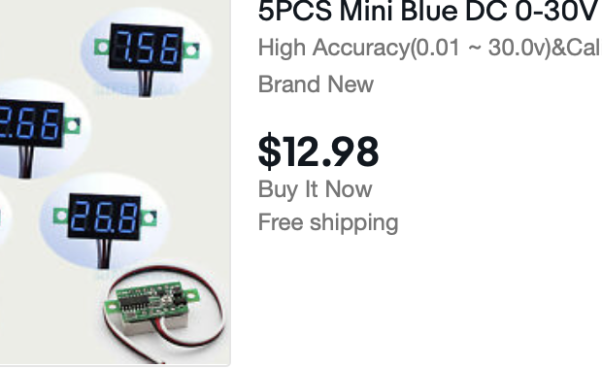
Adding a voltmeter
Free up your multimeter for other measurements
Provide a visual indicator that your power supply is on
Break down the task:
Electrical connections
Mechanical considerations
Ergonomics (human interface considerations)
What should the 3 wires connect to?
Find documentation, or experiment?
Black is often ground (negative) in DC circuits, and (less often) red is positive
Add a resistor in series for safety – how big/small? 5V/1000 ohms = 5mA

Slide 36
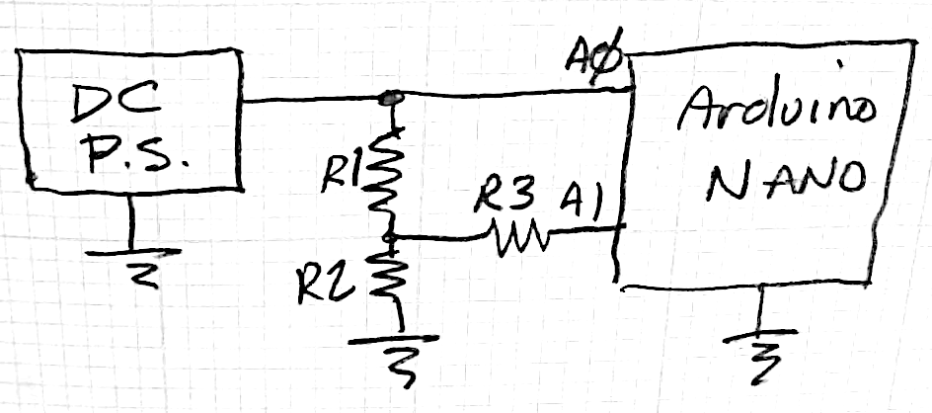
Exploring Arduino Analog Input Resistance
I posted this last week: Sample lab report, we can go over it, but do you have any particular questions first??
Objective: Better understand the DC input resistance of the Arduino Nano analog inputs. My goal is to determine ranges of values of series resistors (R3 in Fig. 1) that might protect the Arduino without introducing measurement errors.
Methods:
1) Documentation – google it.
2) Measure it – measure a voltage in the circuit at right. Set the LM317 to ~2.5V and then don’t touch the pot (>5V will destroy the Arduino). The Arduino software was modified from File→ Examples → AnalogReadSerial. Copy data from the Serial Monitor to Matlab for statistical analysis (mean and std).
void setup()
{
Serial.begin(9600);
}
void loop()
{
Serial.print(analogRead(A0));
Serial.print("\t");
Serial.println(analogRead(A1));
delay(200);
}

Slide 37
Exploring Arduino Analog Input Resistance
Results:
With R1=R2=R3 = 10k and Vin ~2.5V
Change R3 to 1MΩ
Ground A0
Connect A0 to A1
void setup()
{
Serial.begin(9600);
}
void loop()
{
Serial.print(analogRead(A0));
Serial.print("\t");
Serial.println(analogRead(A1));
delay(200);
}

Slide 38
Make Arduino analog input jumpers
Cut one end of a couple of jumper wires
Strip 1/8” of wire and solder to a short lead of a 10k resistor
Cut the other end of the resistor ~1/2” to fit in the breadboard
Think of these analogous to (1x) oscilloscope probes
Remember to connect Arduino analog inputs only using these “probes”

Slide 39
Lab Reports & Quiz
I heard Niel DeGrasse Tyson on NPR’s “Wait-wait don’t tell me”. He missed 2 of 3 questions, to which the moderator said, “Since I knew these answers and the worlds smartest man didn’t, that makes me smarter, and by default, I’m the worlds smartest man”. Tyson replied, “Well from my perspective I learned 2 new things today. If I knew all the answers, then it wouldn’t have been as interesting”
Don’t feel at all bad about missing points – that just means you’re learning …
I posted another sample lab report for an LED night light.
Reminder: Quiz on Canvas

Slide 40
Lab Reports
This formal style isn’t natural and isn’t a blog, but you’ll be well served to learn this form of technical writing …
Past tense (because you already did it)
It should tell a story: Objective (why) → Methods (how) → Results (what happened) → Discussion (what it means, did it answer the original “why”?) → Conclusions (meta-lessons & generalizations)
Liberally use schematics, graphs, photos, … (picture = 1000 words)
Tweak your photos (crop, brightness, sharpness, saturation, …)
Cut figures from data sheets (footnote URL references)
Manage dead space
Who’s your audience? Usually, it’s your boss …
It should be easy to find specific info without reading everything …
As you write, what if you find you’re missing data??
How many data points are necessary?
What if some data is wrong or suspect? What about silly mistakes?

Slide 41
More common issues
Significant figures …
The voltmeter keeps jumping around … what value do I record?
Rth = (Vth-Vr)/i – if Vth=12.20 and Vr = 12.19, then how many significant figs can Rth have?
How much does the LED nightlight cost per month and what should be done to reduce the cost?
Power = VI, we pay ~$.30/kWh for energy = power * time
Include your equations (best in the Methods section)
Why is Vth always > the rated voltage?
Avoid vague statements (and wrong ones)
Is the LED’s I-V curve exponential? It is very steep (vague is better than wrong)
Schematic conventions … lowest voltage at bottom

Slide 42
Details matter …
How many little (or not so little) mistakes do you want your boss to find in your work?
How much are you willing to work to find them first? E.g., proofread?
Also pay attention to the big picture … Is your report
Pleasant to look at (aesthetics matter)
Easy to navigate (e.g., how hard is it to jump to the Discussion if I trust you and don’t care to read your Methods or Results?)
Is it complete (e.g., if you make a statement late in Discussion that your LED nightlight will cost $2/month, have you added the equations or assumptions behind that to the Methods, or as a footnote, …)?
Think about how much a lab report reveals about you …
Is it just a damn homework assignment?
Is it a window into your psyche and soul? (I told you this class goes deep!)

Slide 43
Resistor I-V curves
I forgot to ask you to measure resistor I-V curves
What’s your hypothesis?
It’s easy to do – just replace the LED with a resistor – right?
What value(s) of R?
R1=1K and R are voltage dividers, and we don’t want AIN0 > Vref~4.5V so 4.5=12*R_{max}/(R_{max}+1K)
Do we have to solve that or can we just guess …
Is 1K too big?
500Ω / (500Ω+1KΩ) = 1/(1+2) = 1/3 of 12V=4V works, so less than 500Ω is fine

Slide 44
Methods
Recycle the analysis from before:
>> Vd = data(:,1)*Vref/1023;
>> Vps = data(:,2)*Vref/1023 *3;
>> id = (Vps-Vd); % mA
>> hold on
>> plot(Vd,id,'.-’) % not a diode but an R this time
Matlab has powerful curve fitting tools like
>> help polyfit

Slide 45
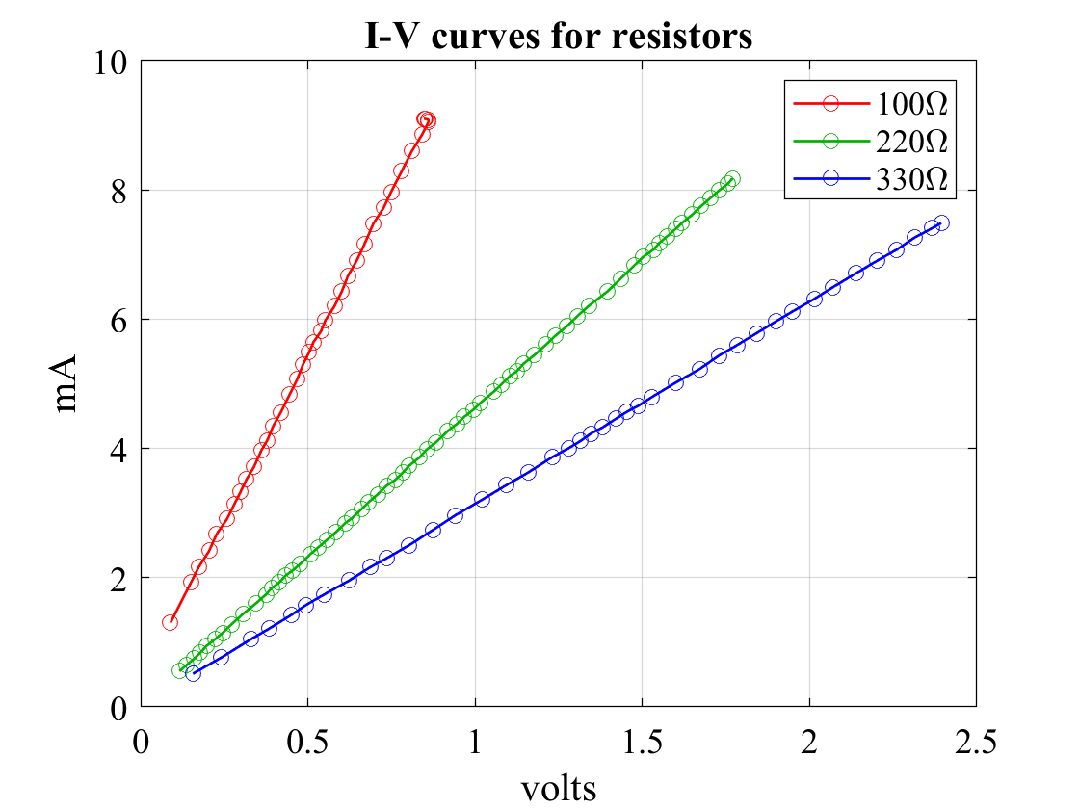
Results

Slide 46
Lessons learned …
The extra initial work to automate really pays off when repeating experiments
We generally need to repeat – we forgot something, have an outlier, …
Lazy programming … I called the resistor’s voltage and current Vd and id because it was easier not to change the code …
you’ll find lots of examples like that in the “real world”, things that only make (some) sense in light of (irrelevant) history
Volts / mAmps = KΩ
Resistors obey Ohm’s Law, V = IR, therefore, they can serve as voltage to current converters, i.e., you can determine current by measuring a known resistor’s voltage
Resistors serve dual functions as current limiters and current indicators

Slide 47
Transistors

